Slide 1

SOFTWARE PROJECT LAB-1
Project Proposal Presentation
K
K E Y T Y P E
Type Like a Pro

Slide 2


INTRODUCTION
KEYTYPE is an educational typing game that will improve user's typing speed and accuracy. It will be interactive and entertaining, making it an enjoyable way to learn typing skills.

Slide 3
OBJECTIVES
Educational purposes: A typing game can help people improve their typing skills and accuracy, which is an essential skill in today's world where most communication and work is done on computers.
Entertainment: A typing game can be a fun and engaging way to pass the time and challenge oneself. It can also be a great way to unwind after a long day.

Slide 4



STAKEHOLDERS
Computer Operator
Programmer
Student

Slide 5



PROJECT GOAL
Solve Real World Problem
Boost up Your Typing Speed
Building strong grip on key

Slide 6
SOFTWARE DEVELOPMENT LIFECYCLE MODEL
REQUIREMENT & ANALYSIS
SYSTEM DESIGN
IMPLEMENTATION
WATERFALL
MODEL
TESTING
DEVELOPMENT
MAINTENANCE

Slide 7


TOOLS & LANGUAGES
Programming Language
Integrated Development Environment

Slide 8
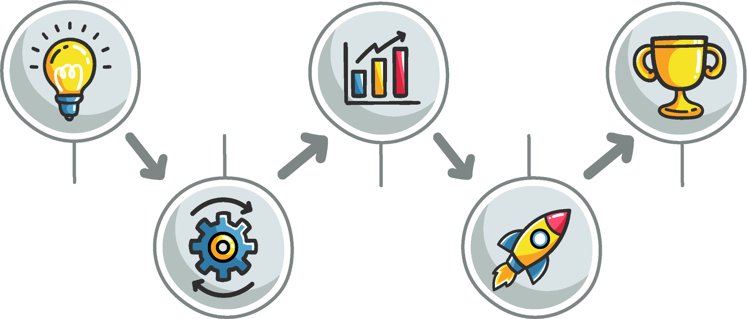
PROJECT TIMELINE
10 MAY
05 JULY
REQUIREMENTS
IMPLEMENTATION
02 APRIL
01 JUNE
20 AUGUST
PROJECT PROPOSAL
SYSTEM DESIGN
SUBMISSION

Slide 9
DELIVERIES
SOURCE CODE
DOCUMENTS
JAR FILE

Slide 10
CHALLANGES
Limited Graphics Capabilities
Limited Color Support
Limited Font Support
Limited Input Options

Slide 11


QUESTION ?

Slide 12



